Slide 1
Learning to Localize Sound Source in Visual Scenes
Arda Senocak, Tae-Hyun Oh, Junsik Kim, Ming-Hsuan Yang, In So Kweon. Senocak, Proceedings of the IEEE Conference on Computer Vision and Pattern Recognition. 2018.
발표자 : 에너지AI 트랙 김소희

Slide 2
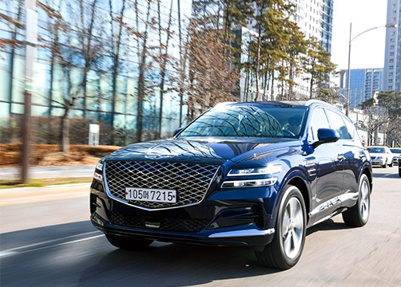
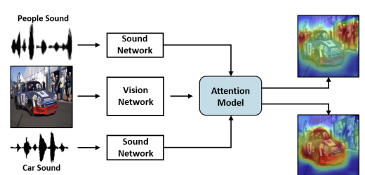
Learning to Localize Sound Source in Visual Scenes
1/13
Introduction
Learning based sound source localization
Human
Car → engine sound
How to learn to localize the sources (objects) from the sound signals
Notes:
When we see that car is moving, we hear the engine sound at the same time.
As shown in example, the engine sound suggests where the source may be in the physical world.
Human unconsciously learn the correlation between visual – audio examples from their whole life. Human can understand and localize the sound source even without seperate education.
In this photo, we can localize sound sources naturally, that means we know where the engine sound come from without any education.
Naturally, videos and their corresponding sounds also occur together in a synchronized way.
The question “Can a machine learning model learn to associate the sound with the visual scene to reveal the sound source location without any supervision similar to human perception?” was a motivation of their work.
So, in this paper, they model the spatial correspondence between visual and audio information by leveraging the correlation between the modalities based on simply watching and listening to videos in unsupervised way, called learning based sound source localization

Slide 3
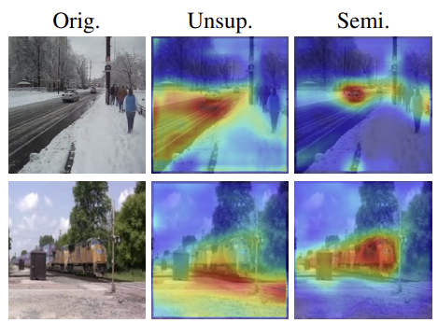
Learning to Localize Sound Source in Visual Scenes
Introduction
Learning task from unlabeled data = challenging
Unconstrained video contains
unrelated audio
audio source that is off the screen
Pigeon superstition
Biases the resulting localization to be unmatched
Semi-supervised setting
Provide some prior knowledge
Add supervised loss
Annotated data
Notes:
The learning task for sound source localization from listening is challenging, especially from unlabeled data. Unconstrained videos are likely to contain unrelated audio to the visual contents or audio source that is off the screen, e.g., narration, commenting, etc
Another challenge is a classical phenomenon in learning theory, pigeon superstition.
It is an experiment about delivering food to hungry pigeons in a cage at regular time. Pigeons believe that their specific action make food arrive, reinforced to do a specific action. Such self-reinforcement occurs regardless of trueness of causality of the event and its chance.
Some of such fundamental issues that naturally occur in the context of animal learning also appear in machine learning.
These biases the resulting localization to be semantically unmatched, in some examples.
Unsupervised are difficult to disambiguate the sound sources without certain amount of supervision, as the picture show.
They correct this issue by semi-supervised setting, pri
They annotate a new sound source localization dataset. Their dataset is the first to address the problem of learning based sound localization.

Slide 4
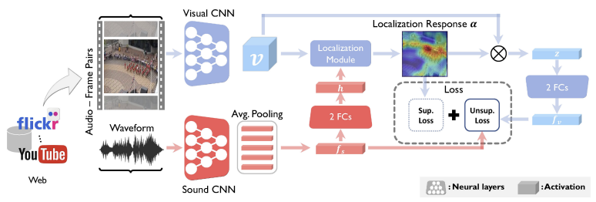
Learning to Localize Sound Source in Visual Scenes
Introduction
Network Architecture
Notes:
They designed model by using 2 stream network architecture (sound and visual network).
It is designed to tackle the problem of sound source localization with unsupervised learning.
The network uses frame and sound pairs to learn to localize the sound source.
I will explain more about architecture later.

Slide 5
Learning to Localize Sound Source in Visual Scenes
Introduction
Network Architecture
The main contributions
A learning framework to localize sound source using the attention mechanism, guided by sound information
A unified end-to-end deep convolutional neural network architecture
unsupervised, semi-supervised, fully-supervised
Collect and annotate a new sound source localization dataset
Notes:
The main contributions of this paper is these 3 things.
They introduce a learning framework to localize sound source using the attention mechanism, which is guided by sound information, with a paired sound and video frame. Thus, the sound source localization can be interactive with given sound input.
They propose a unified end-to-end deep convolutional neural network architecture that accommodates unsupervised, semi-supervised, and fully-supervised learning.
They collect and annotate a new sound source localization dataset, which provides supervised information and facilitates quantitative and qualitative analysis.

Slide 6
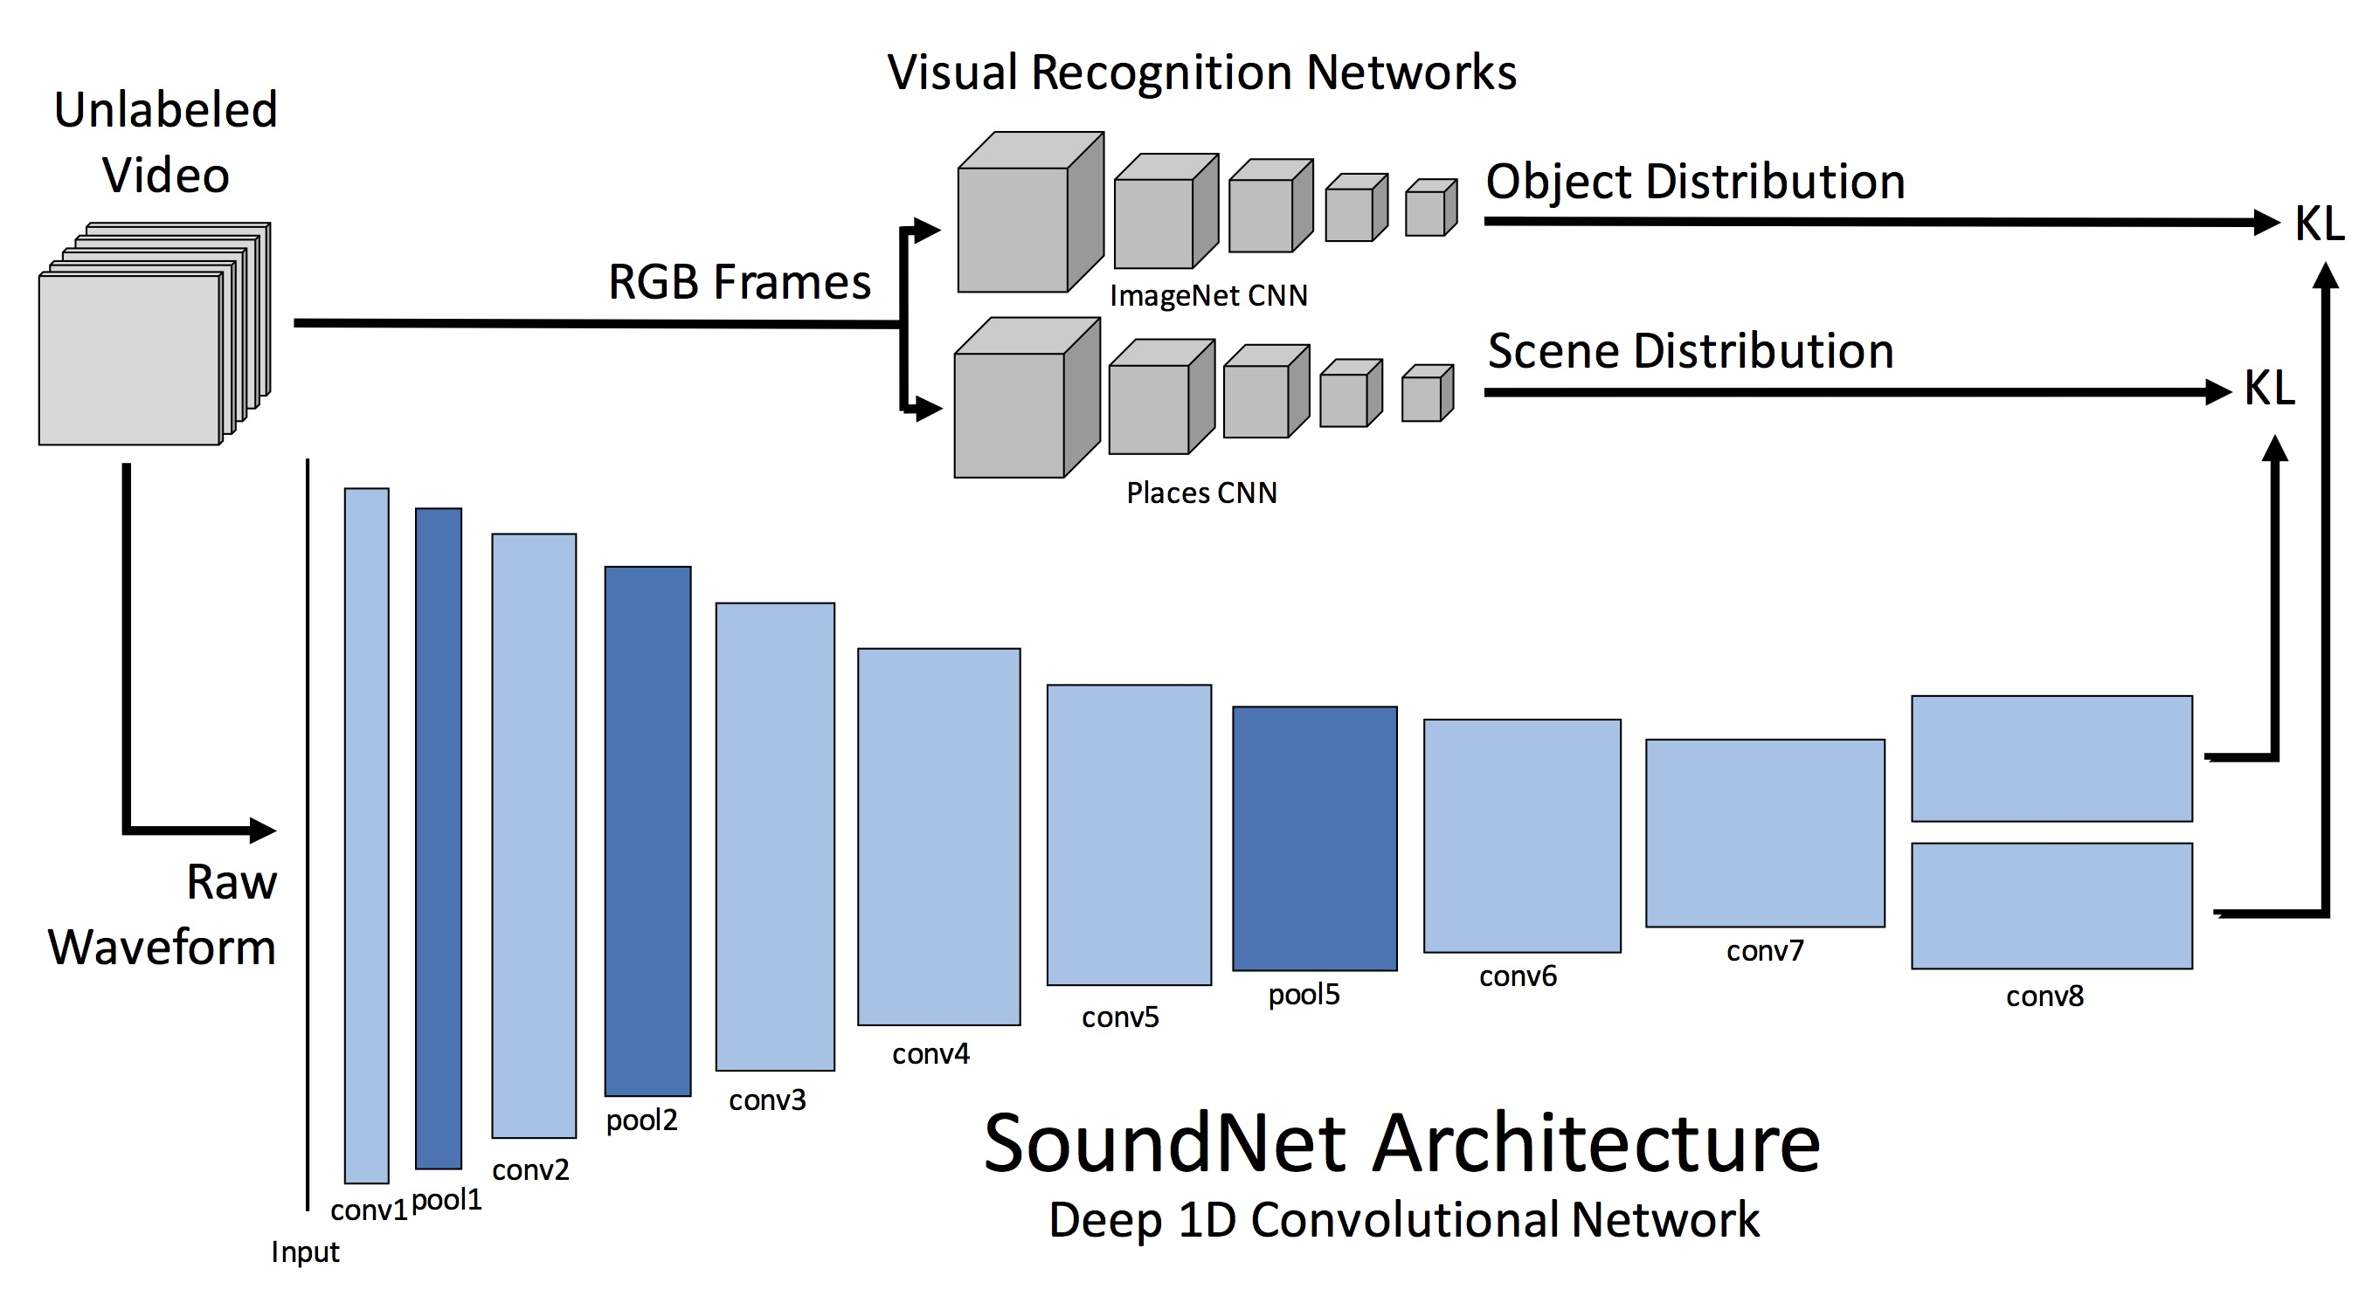
Learning to Localize Sound Source in Visual Scenes
Related Work and Problem Context
Recent work
SoundNet
visual imagery as supervision for sound
Audio module in this work
Aytar et al. and Arandjelovic et al.
Aligned cross-modal representations
Activation maps that localize object → not interactively estimated according to the given sound
A bridge layer
Reveals the localization information of the sound sources

Slide 7
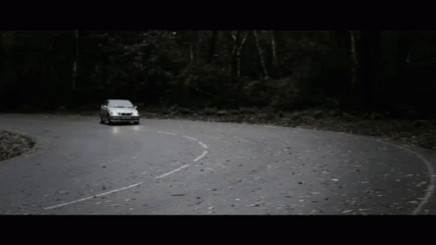
Learning to Localize Sound Source in Visual Scenes
Related Work and Problem Context
Recent work
Sound source localization capability of humans
guided by visual information
two sources of information are closely correlated that humans can unconsciously learn the capability.
Notes:
Containing other studies, It is guided by visual information, and two sources of information are closely correlated that humans can unconsciously learn the capability.

Slide 8

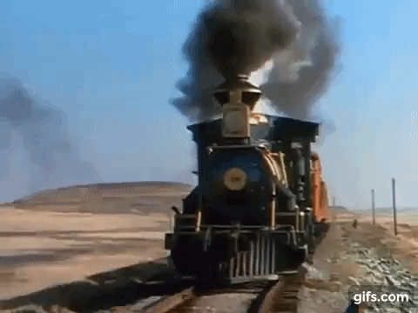
Learning to Localize Sound Source in Visual Scenes
Related Work and Problem Context
Recent work
Deep learning methods rely on
Synchrony of low-level features of sounds and videos
Spatial sparsity prior of audio-visual events
Low-dimensionality
Hand-crafted motion
An unsupervised manner by only watching and listening to videos without using any manually designed constraints such as motion.
Notes:
Containing other studies, It is guided by visual information, and two sources of information are closely correlated that humans can unconsciously learn the capability.

Slide 9
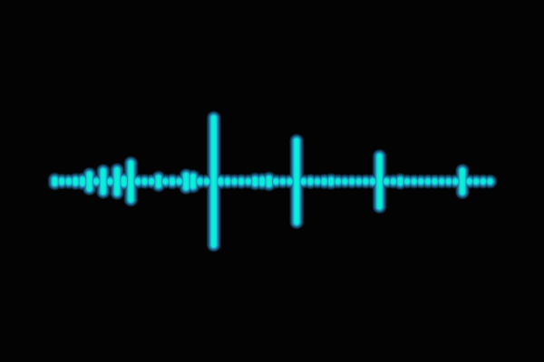
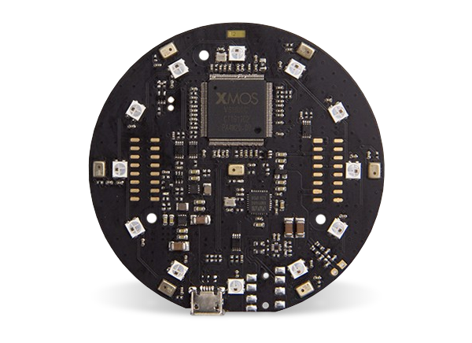
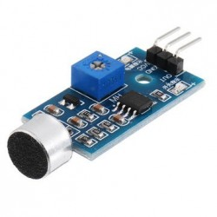
Learning to Localize Sound Source in Visual Scenes
Related Work and Problem Context
Recent work
Acoustic based approach
Requires specific devices (microphone arrays)
Without any special devices but a microphone to capture sound
Notes:
Acoustic based approach [29, 33] has been practically used in surveillance and instrumentation engineering. It requires specific devices, e.g., microphone arrays, to capture phase differences of sound arrival. In this work, we learn sound source localization in the visual domain without any special devices but a microphone to capture sound.

Slide 10
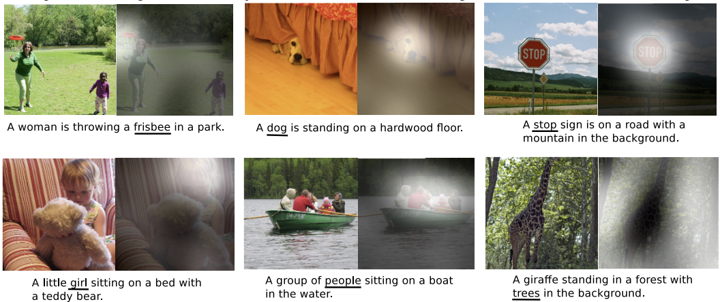
Learning to Localize Sound Source in Visual Scenes
Related Work and Problem Context
Recent work
Attention mechanism philosophy
Interact with sound context and visual representation across spatial axes

Slide 11
Learning to Localize Sound Source in Visual Scenes
Proposed Algorithm
Vision based sound localization within the unsupervised learning framework
Sound network
Visual network
Attention model

Slide 12
Learning to Localize Sound Source in Visual Scenes
Proposed Algorithm
Sound Network
Capture the concept of sound
Convolutional module (conv), rectified linear unit (ReLu), pooling (pool) -> stack 10 layers
1-D deep convolutional architecture : invariant to input length
use average pooling over sliding windows
Input : raw waveform
~ conv8 : SoundNet + 1000filters + averaging pooling (sliding window 20sec)
a single 1000-D vector = sound representation fs
9, 10th layer : ReLu + Fc layers => h (512-D)

Slide 13
Learning to Localize Sound Source in Visual Scenes
Proposed Algorithm
Visual Network
Image feature extractor + localization module
Extract feature :
Input : color video frames (H x W)
~ conv5_3 : VGG-16 model

